Slide 1
Sticking to Human Skin: How Difficult Could That Be?
Synopsis: 40 years of product development experience with 3M creating medical devices that stick to skin has taught me how complicated sticking things to human skin can be. The adhesive categories used in developing these products has include solvent based acrylate, water based acrylate, synthetic rubber and acrylate hot melt, cyanoacrylate, silicone, natural rubber and polyurethane. When developing products that use adhesives and coatings that stick to skin, understanding the properties of the skin, the adhesive and the coated backing is required to create a high performance product. We will explore some of these properties.

Slide 2
Presented by Wayne K. Dunshee Consulting Scientist – Adherent Laboratories, Inc. Retired 3M Corporate Scientist
Adhesives & Sealants Council
Fall Convention & Expo
Greenville,SC

Slide 3
Sticking to Human Skin: How Hard Could That Be?

Slide 4
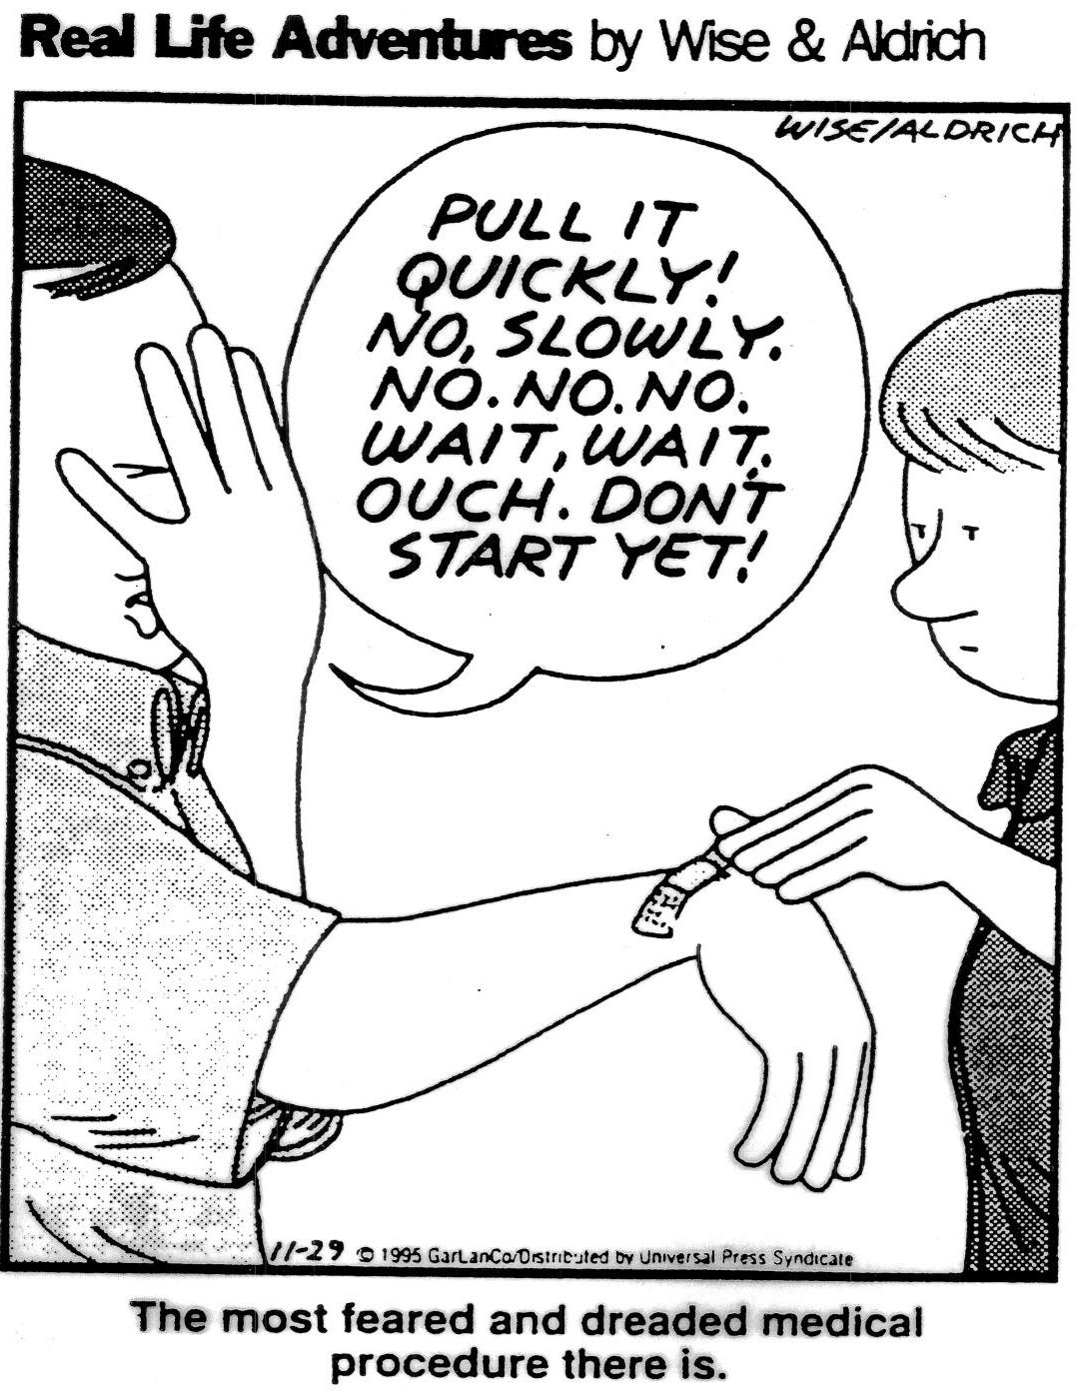

Slide 5
A Brief History of Bandages
It started with animal skins and progressed to woven cloth to soak up blood and wound fluid.
Then there was the discovery that natural rubber adhesive could be spread onto woven cloth and used to more easily hold absorbent materials onto the wounded skin.
This discovery was followed by the use of polymeric adhesives on plastic polymer (PVC) films and began to make bandaging damaged skin not only more comfortable but less obvious.
Synthetic Polymer Adhesive Tapes introduced in 1960
The Beginning of “Technology Driven” Bandages in 1994 (Foam, Nonwoven and Ultrathin Polyurethane) with new and unique adhesives

Slide 6
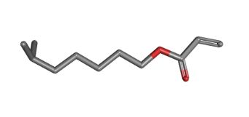
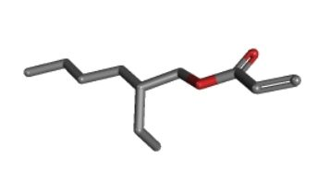
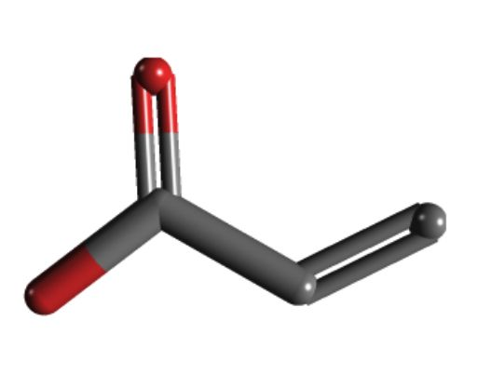
Adhesive Backbone Polymers/Monomers
Natural Rubber Latex cis-1,4-polyisoprene
Iso Octyl Acrylate (3M)
2 Ethyl Hexyl Acrylate (J&J)
Acrylic Acid

Slide 7
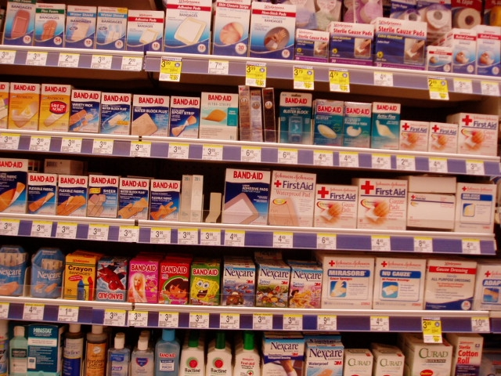
A View of a Typical Drug Store Shelf

Slide 8
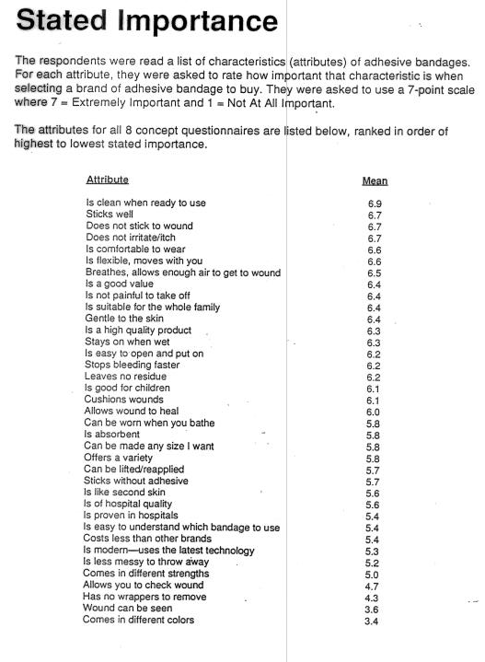

Slide 9
General Bandage Properties
Sterile (only a U.S. requirement)
Ability to stick to skin and stay stuck
Comfortable - reduces irritation to skin
“Breathability” or has holes for evaporation
Pleasant appearance
Easy to remove from the skin
Absorbent Pad

Slide 10
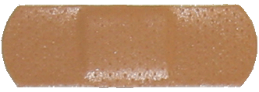
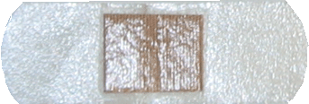
Standard Bandage Shape
Active Strip
(PVC Foam)
Comfort Strip
(Polyurethane non-woven)
Waterproof Strip
(Polyurethane Film)
J&J Sheer Strip
(PVC Film)

Slide 11
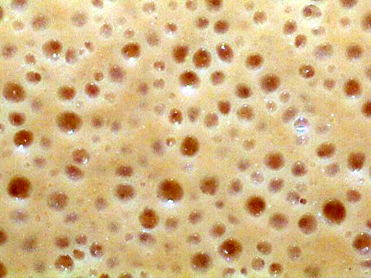
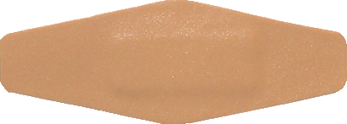
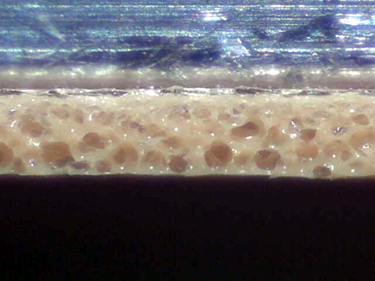
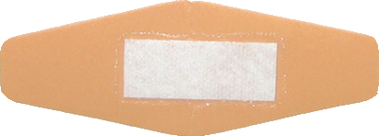
Active PVC Foam Bandage

Slide 12
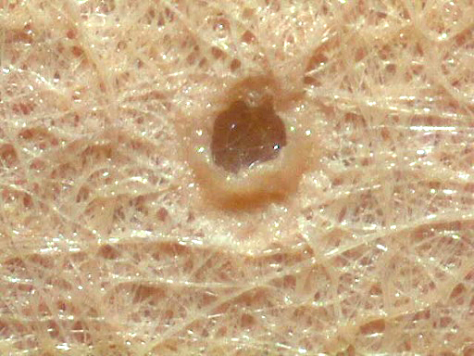
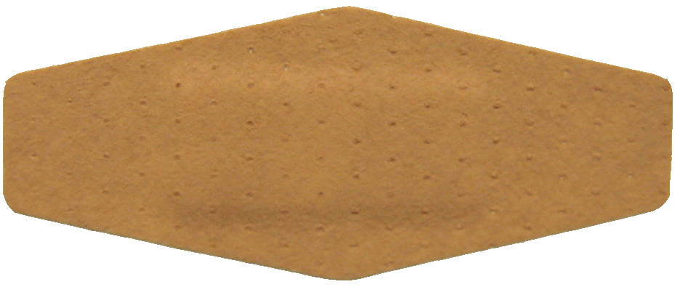
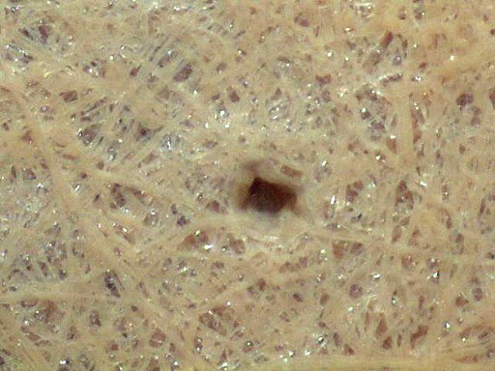
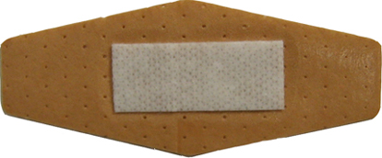
Comfort Nonwoven PU Bandage

Slide 13
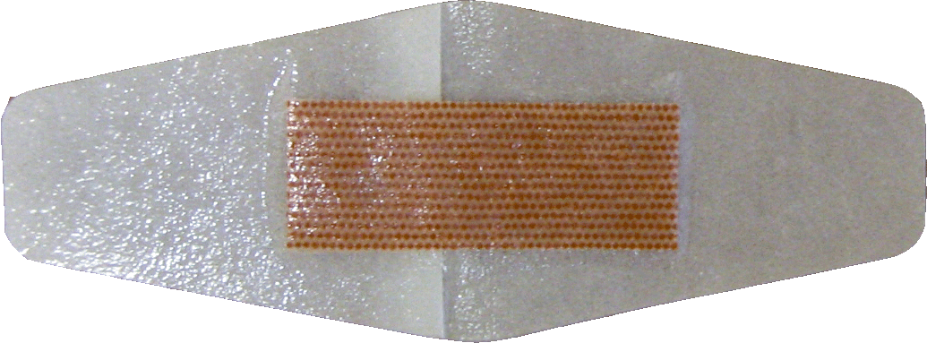
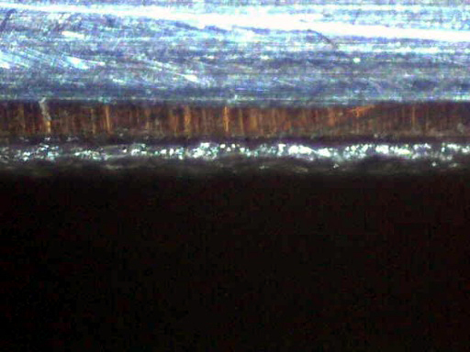
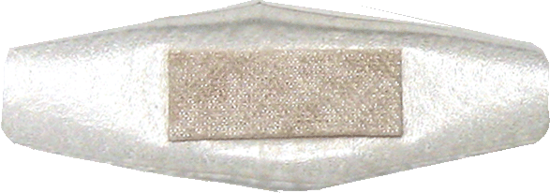
Waterproof PU Film Bandage

Slide 14
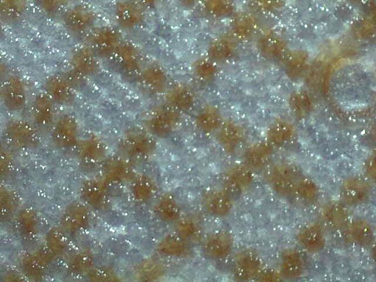
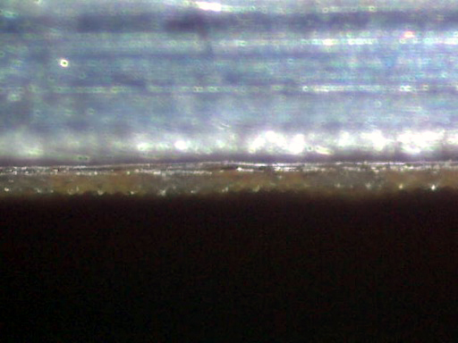
J&J Sheer PVC Bandage

Slide 15
Stress at 50% Strain (Elongation)
Active
(Std. Shape)
Active
(Diamond Shape)
J&J Sheer
(Std. Shape)
Comfort
(Std. Shape)
Waterproof
(Std. Shape)
Comfort
(Diamond Shape)
Waterproof
(Diamond Shape)

Slide 16
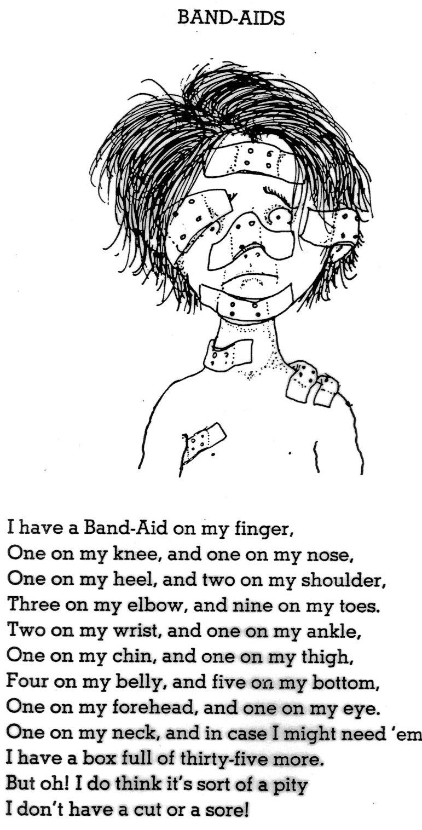

Slide 17
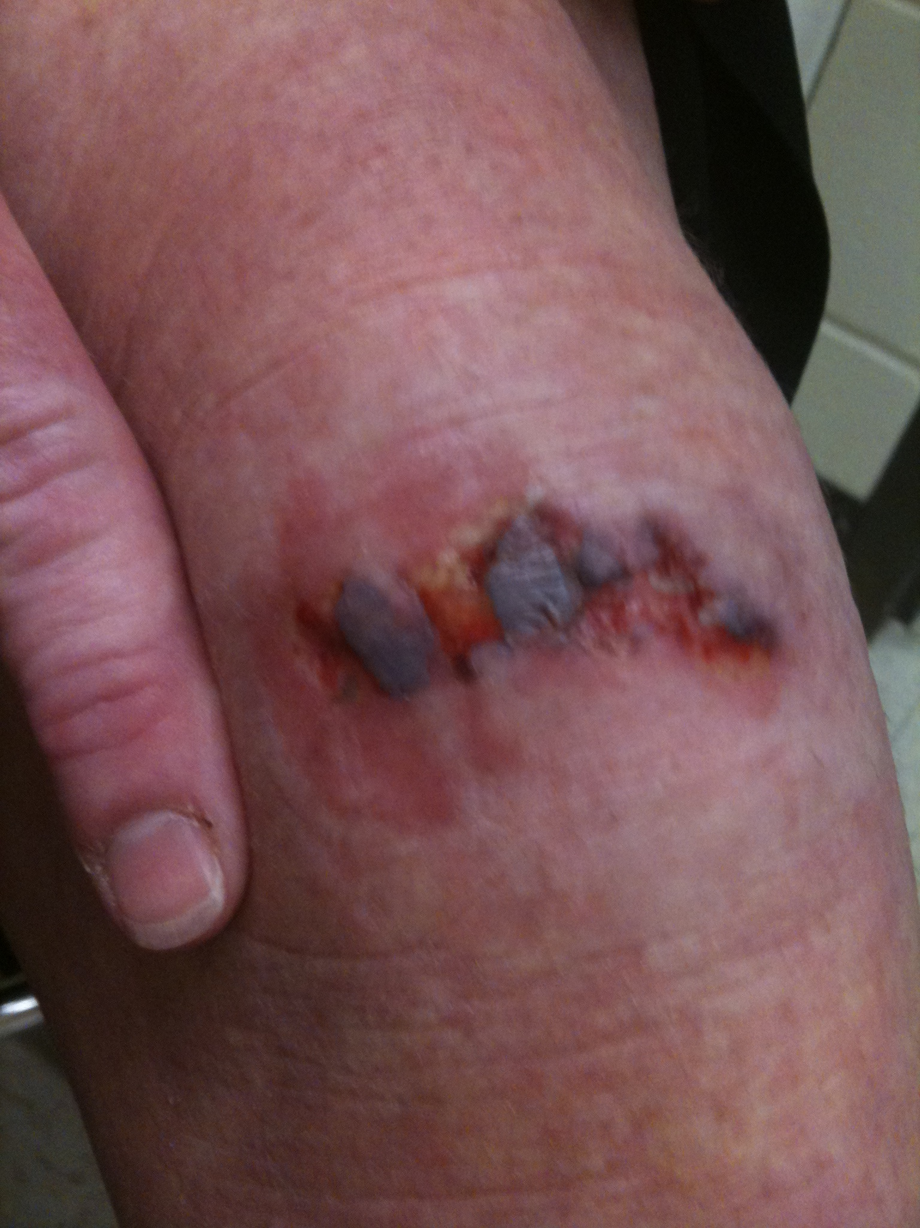
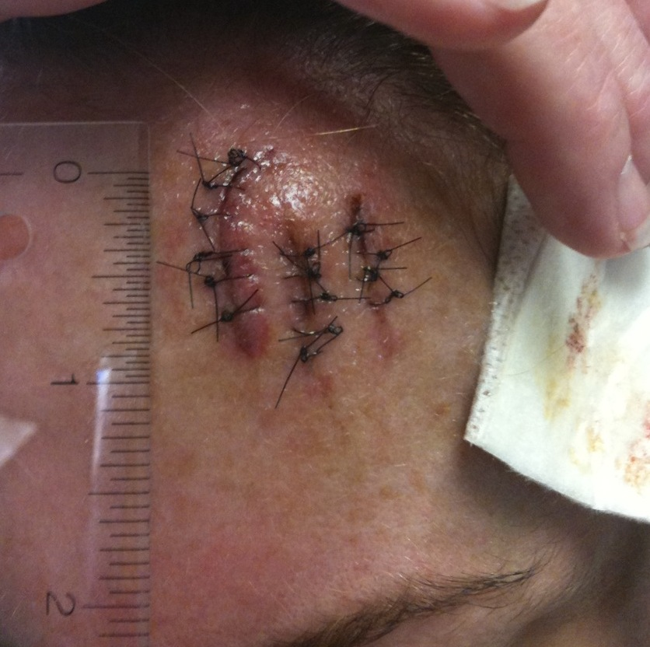
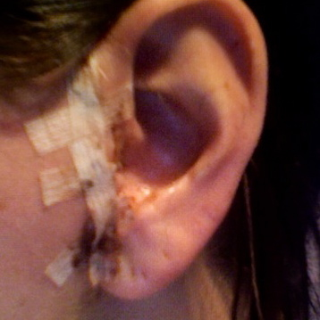
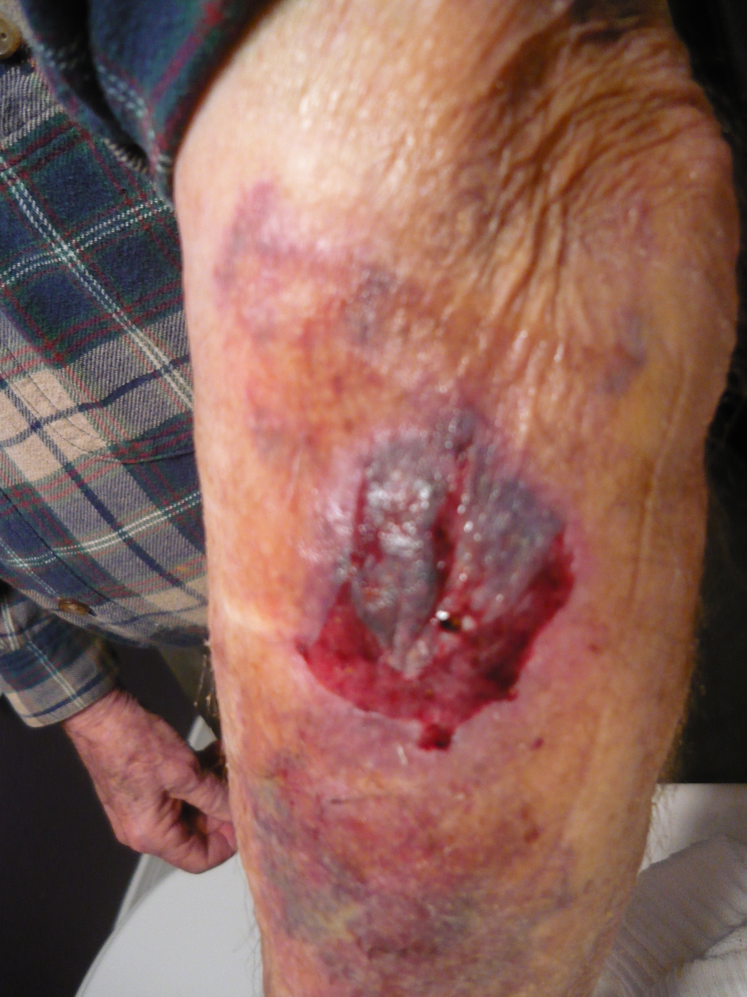
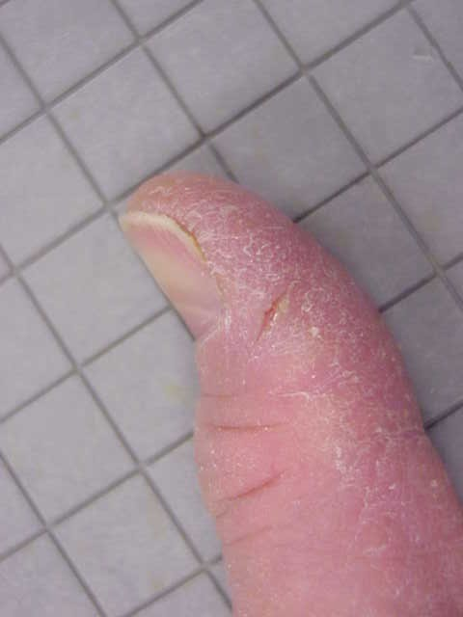
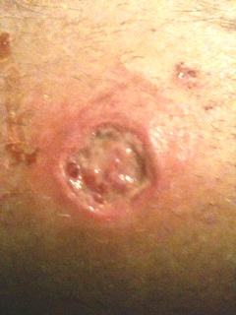

Slide 18
Name 4 things that influence how things stick to your skin

Slide 19
Name 4 things that influence how things stick to your skin
Your Skin
Your Diet
The Weather
The FDA

Slide 20
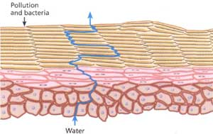
SKIN
The stratum corneum is the outermost layer of the epidermis and is made up of tightly packed layers of flattened cells surrounded by lipids in a “bricks and mortar” structure. It loses around 950 skin cells per sq.cm. per hr.
Skin protects the body from physical trauma, penetration of chemicals, water loss, and infection.
Low humidity, wind, cold, washing with soaps and detergents, and exposure to solvents can lead to dry skin, which sheds more easily.
This is the surface we are wanting to stick to!

Slide 21
Sweat Glands

Slide 22
Sweat Glands Vs. Body Part

Slide 23
Skin Moisture Transmission affects adhesion, and Varies by body location
Daily water losses for an average
1.8 m² surface area individual
0.6–2.3 L/day
hands 1.9-3.8 L/day
feet 1.2-3.6 L/day
Head & neck 0.96-1.8 L/day
All other skin sites 0.36-1.4 L/day

Slide 24
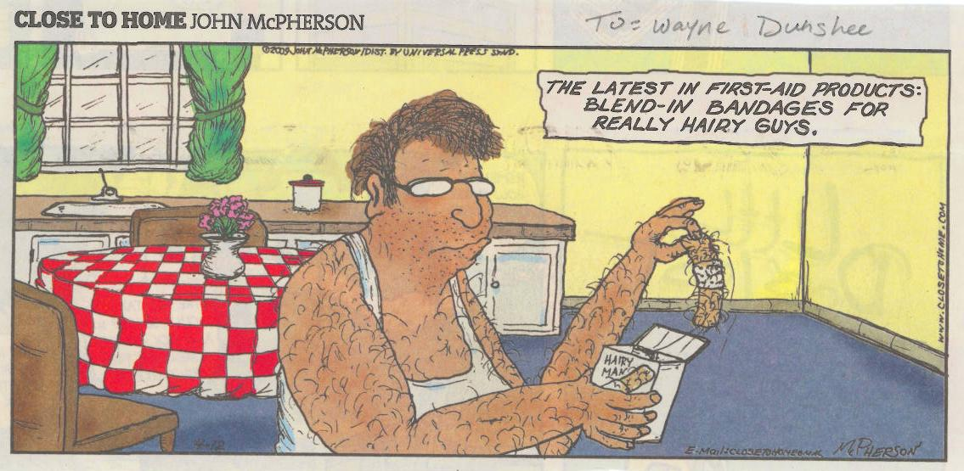
Hairy Skin Conditions

Slide 25
Skin, Hair, Oil Glands, and Diet

Slide 26
Weather/Climate

Slide 27
What about the rest of the world? Most U.S. Business Thinking is about American products.
Bandages are not alike around the world.
The first comments I had from my CEO (born in the UK) was about our bandages and how none of them stick very well.
In some parts of Europe, if the plaster does not hurt when you remove it, it “does not stick very well”.
Natural rubber adhesives are well liked in hot climates because they perform well.
Sensitivity to natural rubber seems to be mostly an American health care worker problem.
Data on the usage and performance of bandages in India is needed – an untapped market
“Bandage performance needs” change with the age and physical condition of the user.
Other Considerations for removal: Hair encapsulation, Stretch Release, Polymer skin coatings

Slide 28
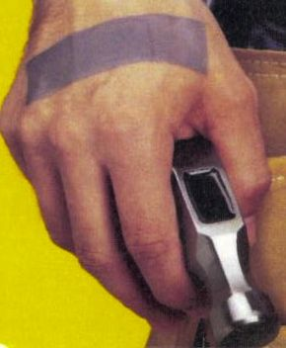
The case of the Duct (Duck) Tape Bandage

Slide 29
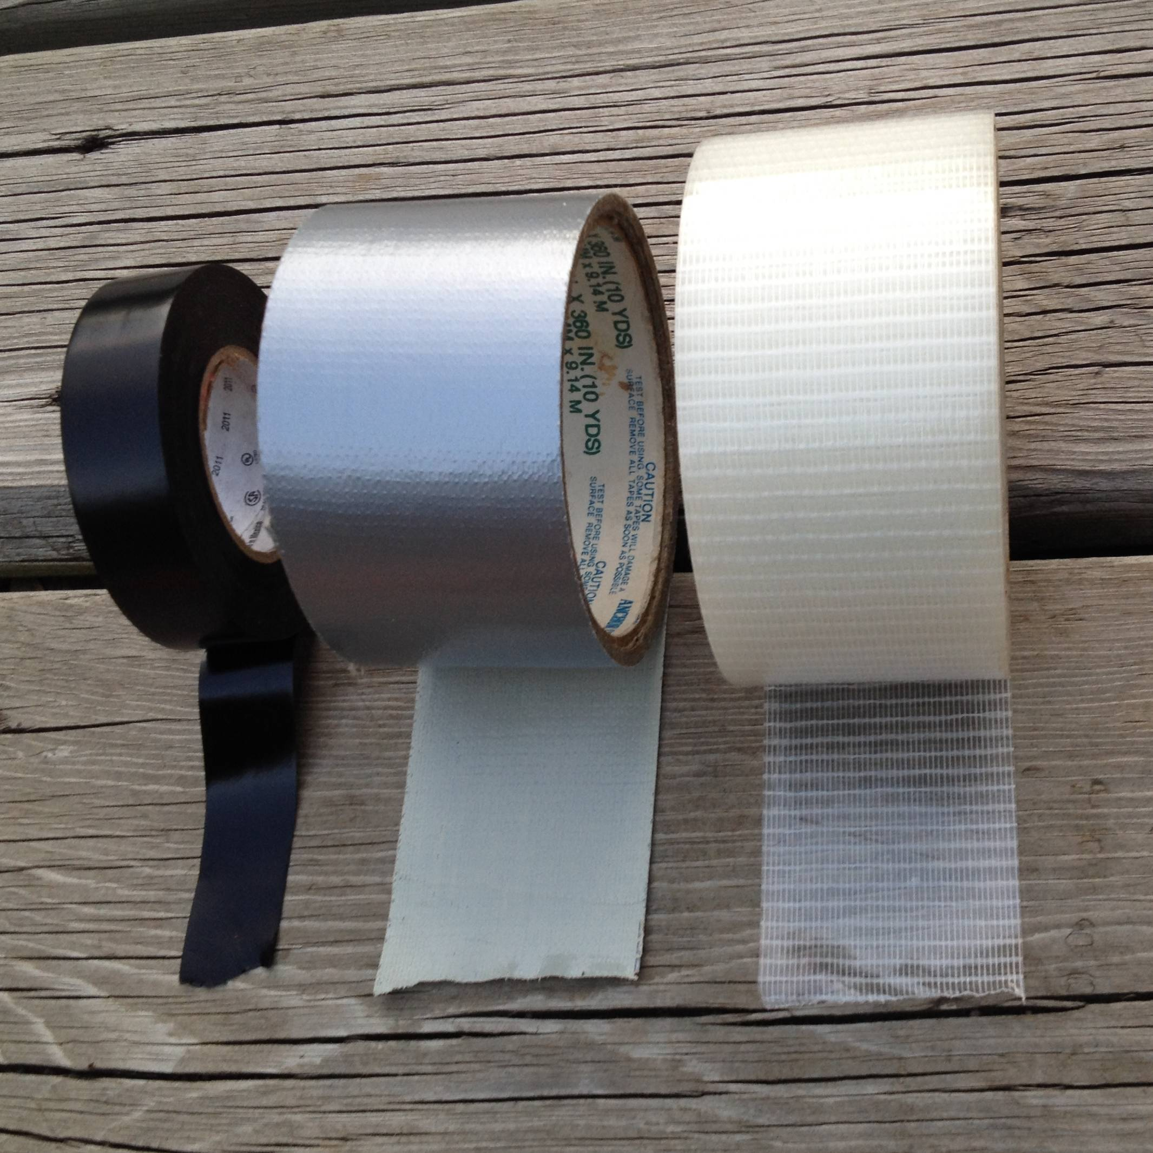
Workmen commonly use
Electrical and Duck Tape for Bandaging

Slide 30
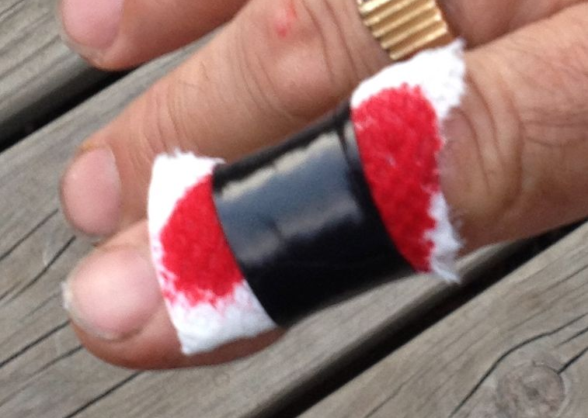
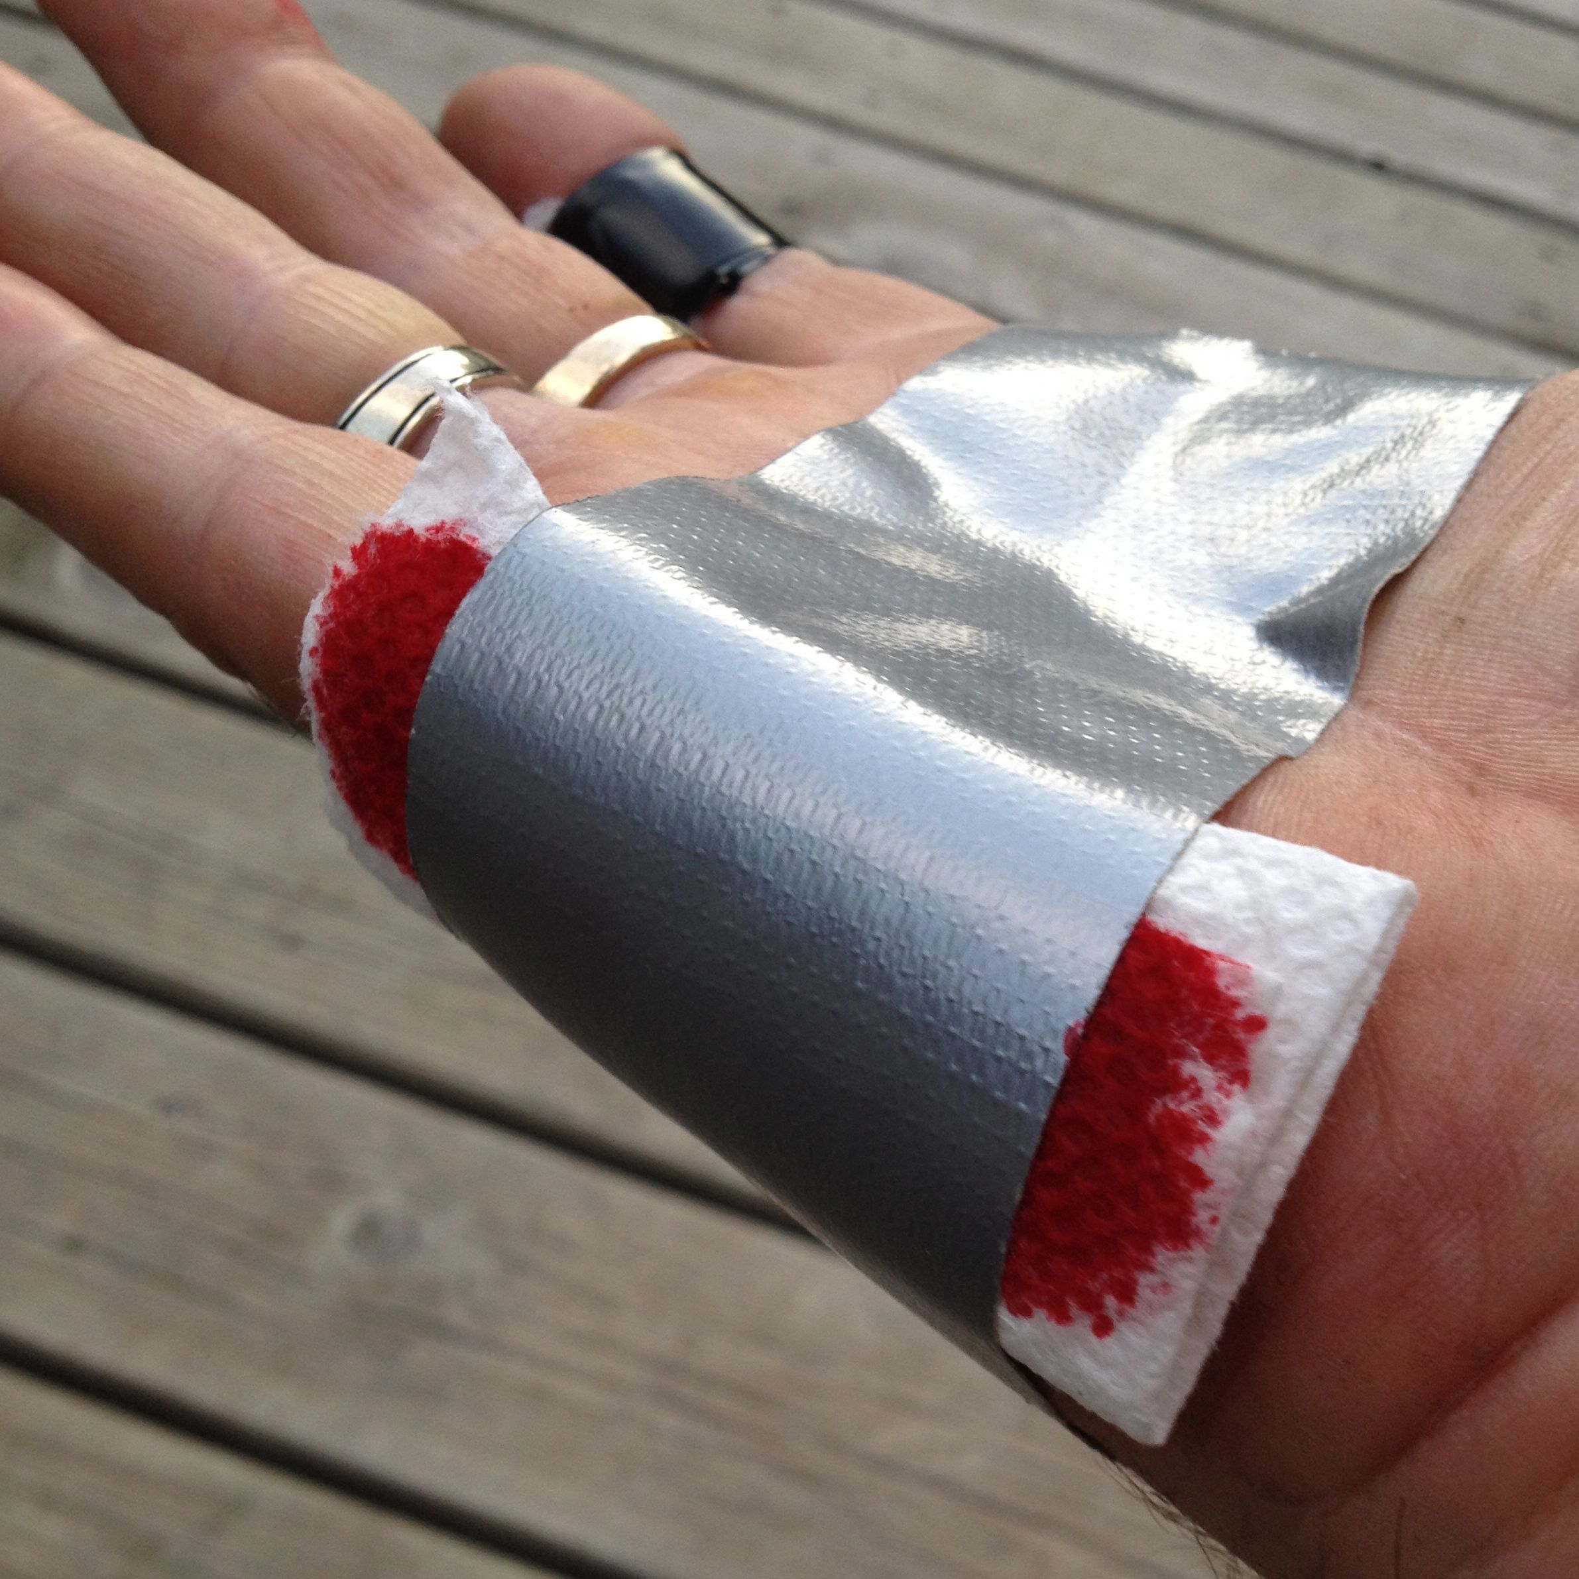
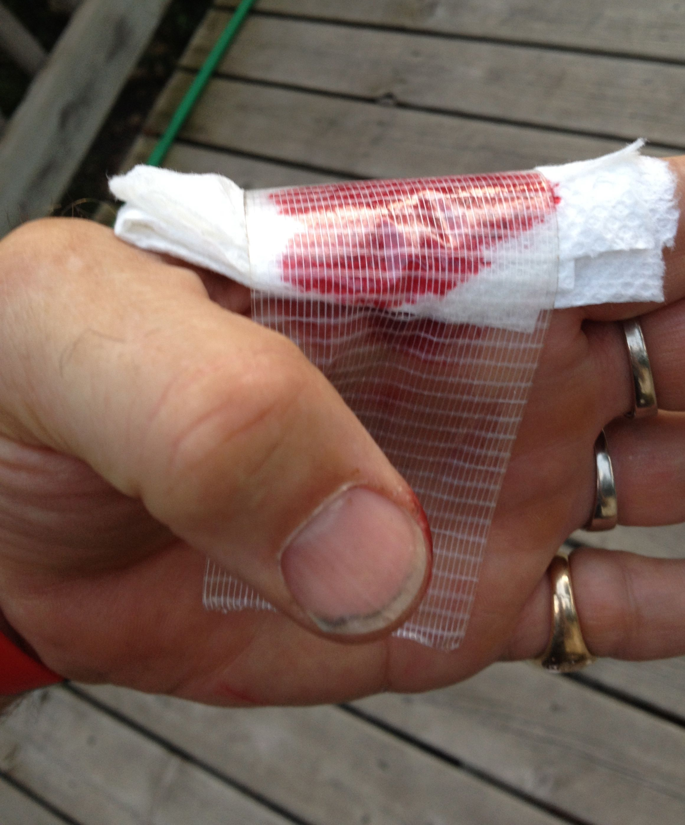

Slide 31
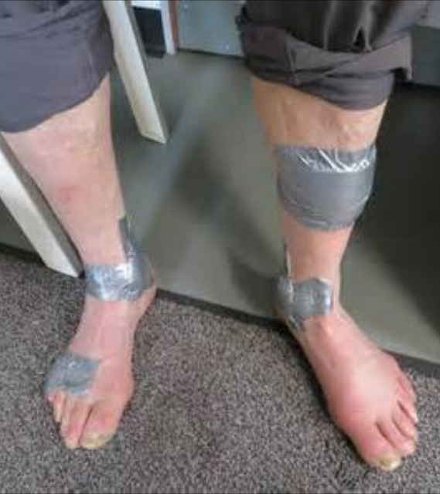
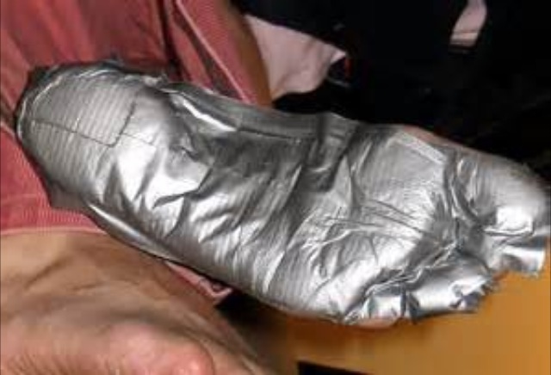
Duct (Duck) Tape Used on Skin

Slide 32
SELLING a tape to use on the skin creates an FDA regulated Medical Device
First Aid Bandages and Tapes are Medical Devices
Medical Devices must have data that supports safety and efficacy.
Safety requires the device to be made from materials that are known and are non-toxic. This includes polymers, residual monomers, fillers, plasticizers, colorants, inks, and adhesives.
Efficacy means you have data to determine what happens on the skin. Adhesion, irritation, etc.

Slide 33
Medical Devices Require Special Manufacturing Processes
Medical Devices Require FDA Approved Manufacturing Processes, Known as GMP
Traceability of all input materials
Cleaning and maintenance of equipment
Training of operators

Slide 34
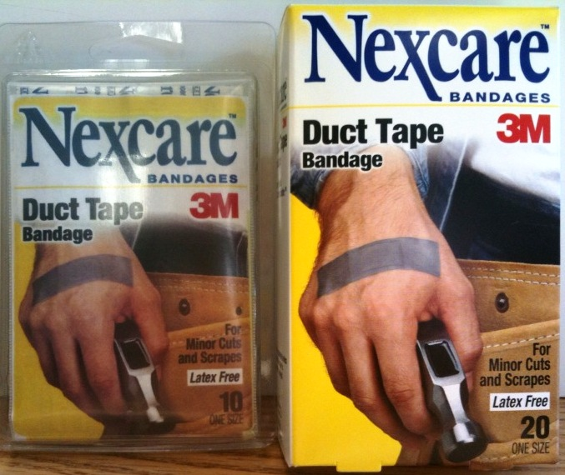
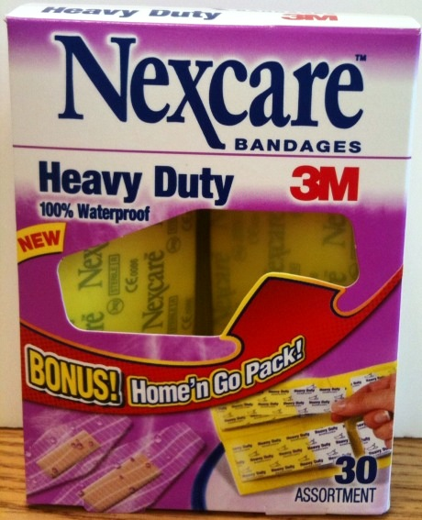
The Working Man’s Bandage
The ONLY Class 1 Medical Device Duct Tape
that is safe for use on skin

