Slide 1
Recyclability drives adhesive development
Fred Gustafson, Ph. D
Adherent Laboratories, Inc.
St. Paul, Minnesota
fred.gustafson@adherentlabs.com
www.adherentlabs.com

Slide 2
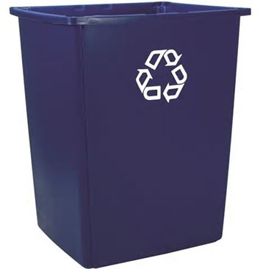
Contents
Recycling rates in the US
Paper recycling
Impact of adhesives
Test methods
PSA products: labels, tape, and notes
PET bottle and thermoform recycling
Impact of adhesives
Test methods
PSA labels
Business considerations
Solving the problem

Slide 3
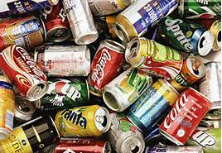
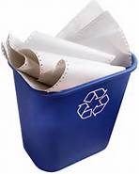
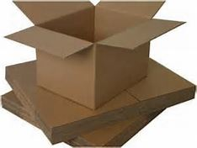
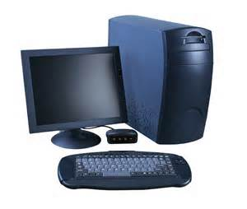
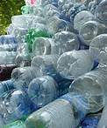
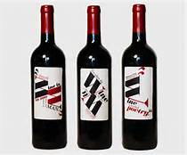
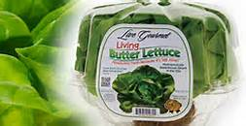
Recycling rates in the US
95%
Autobytel
91%
CPA
67%
Al Assoc.
65.1%
AF&PA
47.8 MM lb
NAPCOR
Rate not available
27.8%
CRI
38%
EPA
31%
APR

Slide 4
Citations – recycling rates
Al Assoc. – Aluminum Association
Autobytel – Automobile web site
AF&PA – American Forest and Paper Association
APR – Association of Postconsumer Plastic Recyclers
CPA – Corrugated Packaging Alliance
CRI – Container Recycling Institute
EPA – US Environmental Protection Agency
NAPCOR – National Association for PET Container Resources

Slide 5
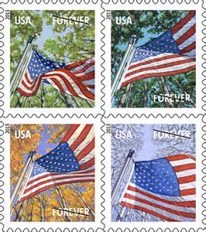
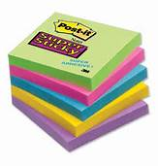
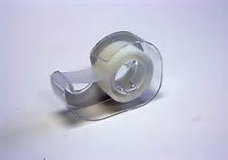
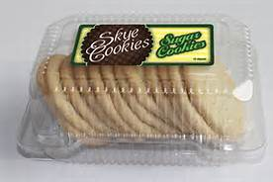
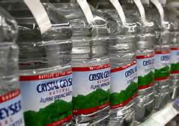
Adhesive products impacting recycling
Sticky Stamps
Repositionable Notes
Tape
Paper Labels
Labels for PET food containers
Labels for PET bottles

Slide 6
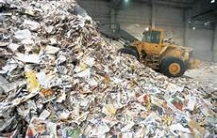
Paper recycling facts
Recycling rate for paper is 65% and for corrugated is 91% (2012)
70 MM tons of paper and corrugated are recycled in the US every year
Adhesives are contaminants and must be removed from paper during recycling
Adhesives are more of a problem with fine paper than corrugated
Adhesive contamination is a huge cost to the recycled paper industry
Recycling mill down time and clean up cost
Estimated cost was over $500 MM per year in the 1990’s
Recycled paper companies still complaining about adhesives

Slide 7
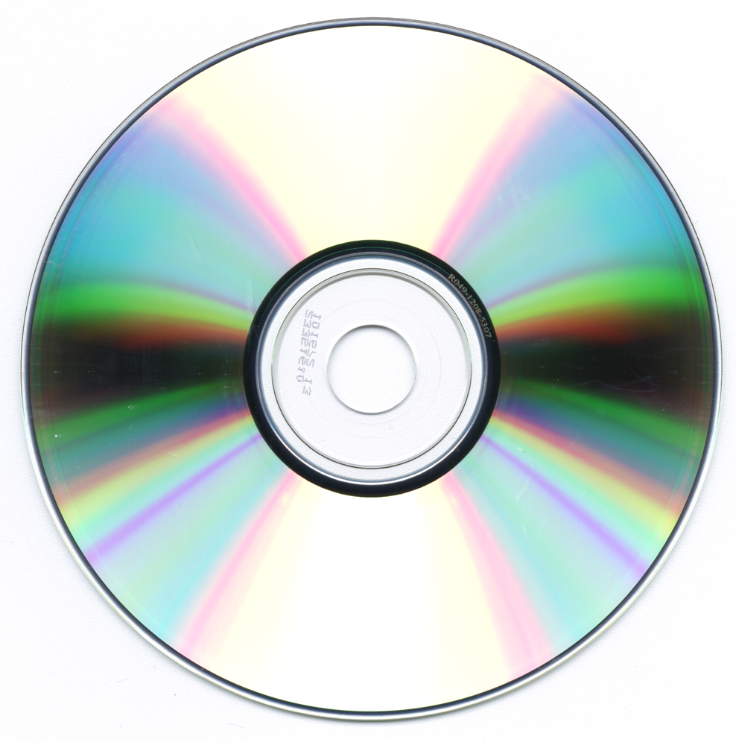
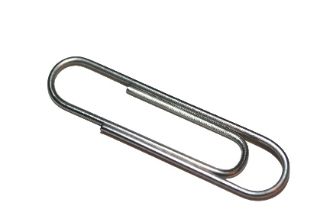
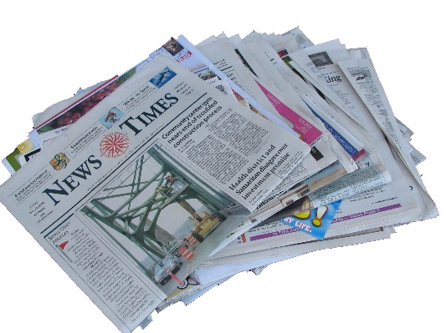
Contaminants in recycled paper
Must be removed during the recycling process
Plastic – CD’s and folders
Metals – staples and paper clips
Ink and toner powder
Color – dyes and pigments
Coatings – coated paper
Adhesives

Slide 8
Adhesives and paper recycling
Water insoluble adhesives
Adhesives will adhere to the wire of a paper machine
Causes a repeating hole in the paper
Expensive clean up required
Water soluble adhesives
Adhesives build up in the waste water of the recycling mill
Adhesives can precipitate with a pH or temperature change
Expensive clean up required

Slide 9
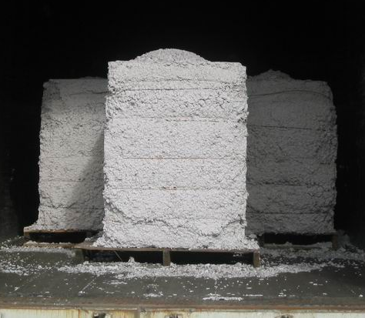
Paper recycling unit operations
Pulping
Water and agitation turns paper into pulp
Screening with slotted screen
Removes large contaminants > 100 um diameter
Flotation – air bubbles and surfactant
Foam carries small particles to the surface with the foam
Centrifugal cleaning - spinning
Removes light or heavy contaminants
Dispersion and washing
Removes small contaminants, inks and fillers by filtration
Bleaching with hydrogen peroxide
Removes color
Recycled paper pulp

Slide 10
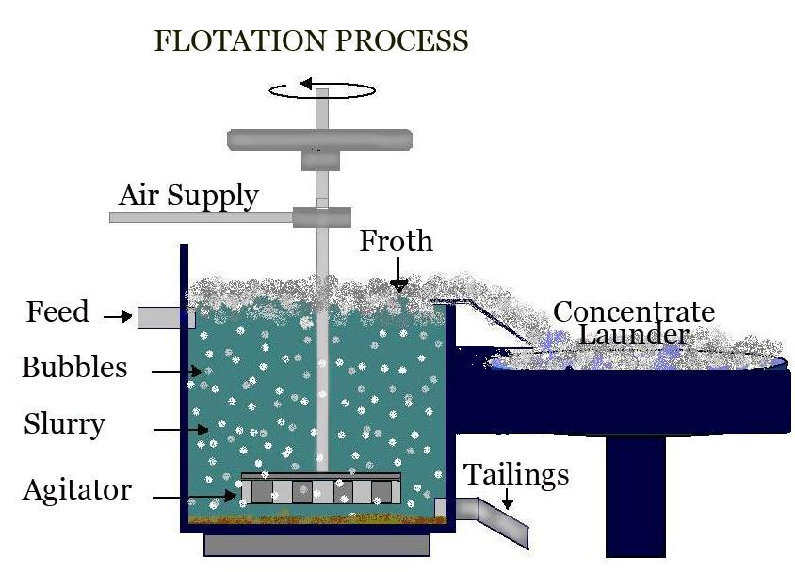
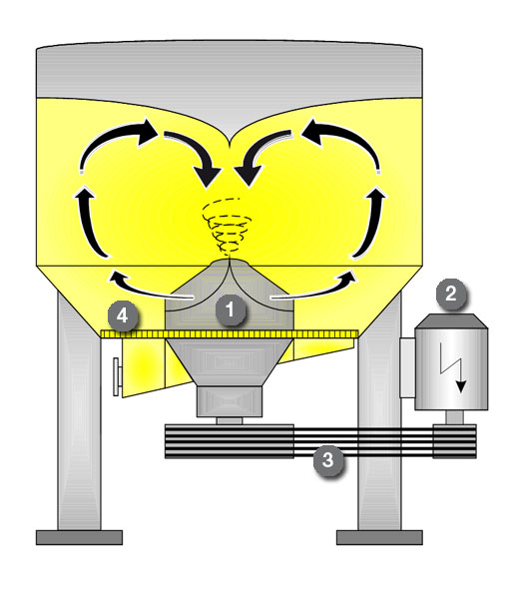
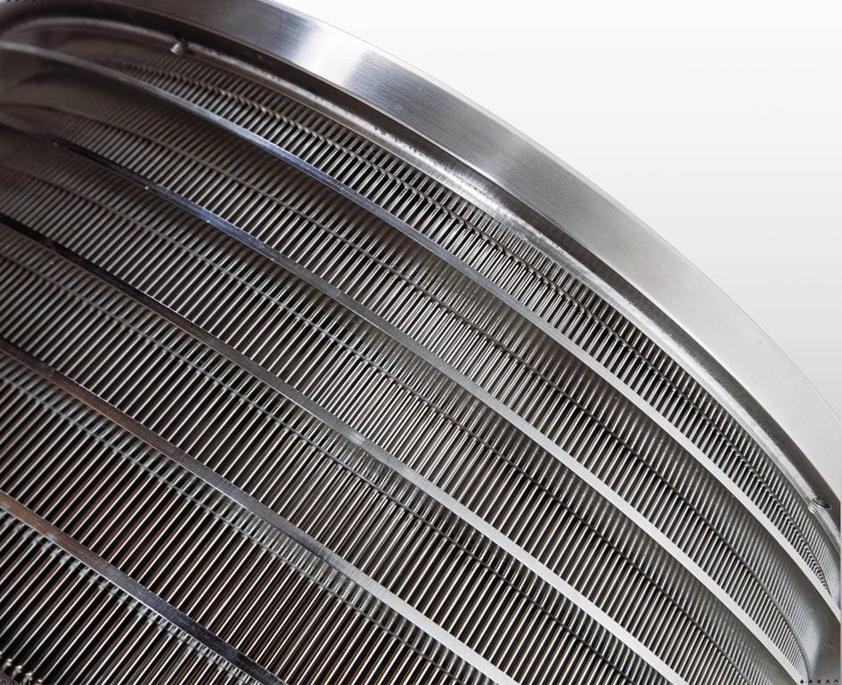
Pulping, screening, and flotation
Pulper
Screen
Flotation

Slide 11
Adhesive removal
Waste paper is pulped in a large tank (pulper)
Avoid shredding of adhesive into smaller particles
Large adhesive particles are removed by a series of slotted screens
Smallest screen is typically 0.004” or 100 µm opening
Small adhesive particles are removed by flotation
Surfactant and air will bring small contaminants to the surface as a foam
Optimal size for removal is about 20 – 100 µm

Slide 12
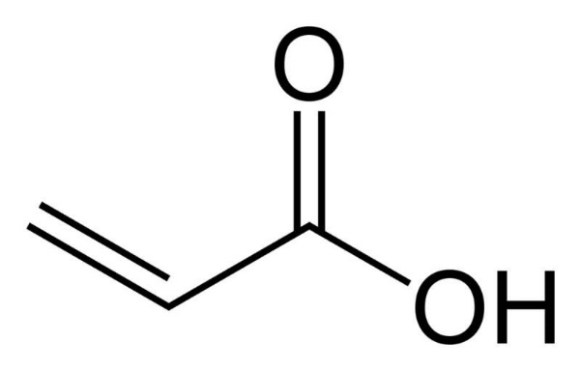
Acrylic pressure sensitive adhesives
Many acrylic adhesives will extrude through the screens
Particles are then too large to be removed by flotation
Solution
Increase the elastic modulus of the adhesive so that will be removed by screens rather than extrude through the screen
Facestock and adhesive surface properties also impact removal efficiency
Reference:
Controlling Adhesive Behavior during Recycling, Carl Houtman, et. al, 7th Research Forum on Recycling, Pulp and Paper Technical Association of Canada, 2004

Slide 13
Test protocols for labels (Adhesives on paper products)
Tag and Label Manufacturers Institute (TLMI) web site:
tlmi.com/sustainability
Introduction to Recycling Compatible Adhesives
Specification for Paper Labels Coated with Recycling Compatible Pressure Sensitive Adhesives
Laboratory Testing Protocol for Paper Labels Coted with Recycling Compatible Pressure Sensitive Adhesives
Mill Recycling Trial Protocol
Image Analysis Protocol - Determination of Adhesives in Paper Handsheets by Image Analysis

Slide 14
Self Adhesive Stamps
Introduced by the USPS in 1991
Popular with consumers, but protested by the recycled paper industry
USPS funded project on “Environmentally Benign Adhesives”
Adhesive suppliers, converters, and paper industry participation
Developed test methods for adhesive removal from paper
Developed adhesives that were removed at 99.9% in laboratory test
Tested the stamps in six recycling mills in the US
Developed a specification for stamps with benign adhesive
Key improvement > 90% of adhesive removable by screens
Converted all sticky stamps to benign adhesives in the year 2000
Reference:
USPS-P-1238F, Specification, Pressure Sensitive Adhesive Stamp

Slide 15
PSA Paper Labels
Fred Gustafson
Street Address
Bloomington, MN 55438
Recycling compatible stamp adhesives also work for paper labels
TLMI (Tag and Label Manufacturers Institute) Committee on Recycling Compatible Adhesives (RCA)
Issued the specifications and test methods previously cited
Worked with adhesive suppliers to encourage development of better adhesives
Worked with converters to promote recycling compatible adhesives
Recycling compatible paper labels are available for retail and commercial applications
Estimated adoption rate is less than 50%

Slide 16
Repositionable notes and labels
Microsphere adhesives
Common adhesive technology but not the only technology
Microsphere adhesives are too small to be removed by screens
Flotation is the best method to remove the adhesive
Solution
Test products for adhesive removal by TLMI test protocols
Optimize adhesive size and chemistry for removal by flotation
Stripe coating reduces overall adhesive coating weight

Slide 17
3M experience with repositionable products
Most paper recyclers banned repositionable notes in the 1990’s
Some businesses and government offices stopped buying the product
Testing
Laboratory and mill scale experiments
USPS and TLMI protocols for recycling compatible adhesives
Adhesive optimization R & D
Discovered control handles on adhesive removal
Commercialized better adhesives
Product claim: All Post-it® Notes and Easel Pads are recyclable
Product contains recycling compatible adhesive. During the paper recycling process, the paper is recycled and the adhesive is removed.

Slide 18
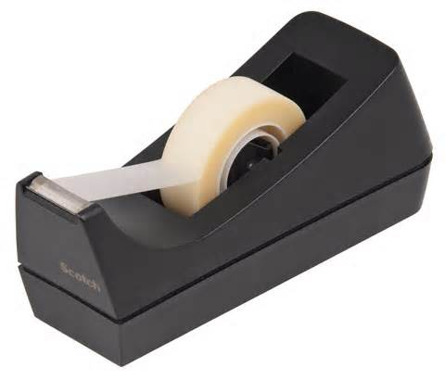
Film Tapes and Labels
Adhesive is coated on a polymeric backing
Pulping and screening
The plastic backing remains intact during pulping
Removed by screens
Potential problem
If the adhesive is separated from the backing during pulping, the adhesive can contaminate the pulp
Solution
Reformulate the adhesive
Develop a primer that keeps the adhesive attached to the backing in water

Slide 19
PET bottle and thermoform recycling
Adhesives come from the labels on PET bottle or thermoform
Labels must be removed from the PET material during recycling
Contamination caused by adhesive, paper, or ink:
Residuals – organic material will char when the recycled flake is extruded to make a new product
Residuals can contaminate the recycling equipment
Black specs from ink will carry over into new product
Fluorescence from residual components is unwanted

Slide 20
Test Protocol for PET Thermoforms
Sample preparation
Mix PET flake with water, 0.3% surfactant, and 1% NaOH
Heat to 88°C for 15 minutes with agitation
Remove floatables and sinking solids
Rinse with water
Testing
Color of dry flake
Fluorescence of dry flake
Black specs over 10 mils (0.1”) diameter
Reference: Association of Postconsumer Plastic Recyclers
Protocol for Evaluating PET Thermoform Labels and Adhesives for Compatibility with PET Recycling

Slide 21
Key learning
Contamination of flake is caused by adhesives, backing, and inks
Best label properties
Label completely removed from the PET surface under the test conditions
Filmic backings appear to leave fewer contaminants than paper backings
More work needs to be done to identify the best label properties
Active collaboration between:
Adhesive suppliers
TLMI – Tag and Label Manufacturers Institute
APR – Association of Postconsumer Plastic Recyclers
NAPCOR – National Association for PET Container Resources

Slide 22
Traditional adhesive life cycle
End User
Disposal
Landfill
Adhesive
Product
Old Paradigm

Slide 23
New paradigm
End User
Recycler
New Product
Adhesive
Product
Feedback
Adhesive removal

Slide 24
Advantages of compliance
Triple bottom line
Profit, stakeholders, and environment
Make product claims with the test protocols
My product does not interfere with recycling
Avoid loss of business
Participate in joint development projects
Share the costs of technology development
Keep up with inevitable technology advancement
Counterbalance: cost of research and development

Slide 25
Model for recyclability research projects
Lead organization to organize or sponsor research
Participation by adhesive, product, and recycling industries
Research program with shared results
Confidentiality of adhesive compositions
Adhesives identified by type only
Equitable distribution of cost
Test method development
Specification
Adoption by the industry

Slide 26
Adherent Laboratories, Inc. St. Paul, Minnesota
Adhesive, sealant, and coating specialist company
Laboratory services
Adhesive and raw material development
Laboratory coating and adhesive evaluation
Core competency in hot melt adhesives
Consulting services
Adhesive specifications
Market and technology assessment
Product design and failure analysis
Web site: www. adherentlabs.com
Changing the way you look at adhesives

