Slide 1
Potential of High Polymer Content Adhesives for Non-woven Applications
Presented by
Steve Albrecht
Technical Director
Adherent Laboratories

Slide 2
50 Years and Counting…..
Early 1970’s – Technology was EVA/tackifying resin blends
  Low cohesive strength
  Not good performance at body temperature
APAO based adhesives introduced in 1975
  Improved thermal resistance of EVA/tackifier
  Made from PP by-product from earlier production, then mined and cleaned for use
  These materials became scarce later in 1970’s
    Process technology minimized by products
    Supply of old material expired

Slide 3
SBC Takes the Stage
Start of 1980’s gave technological advance of SBC materials
  Low viscosity, high cohesive strength formulations
    Highly formulated products – low polymer content
  Could be customized for use and application
    Needed oil as plasticizer to have PSA character
    Rubber came in varieties to impart different properties
  Handling of PSA required different equipment and processes
    Drum unloader for drums
    Emergence of co-extruded pillows, chubs and other packaged forms

Slide 4
SBC – Pros
SBC set and maintained a technological advantage
  Further development of polymer grades → higher performance adhesives
  High Mw and Styrene to minimize rubber and maximize oil for cost savings
  Even higher cohesive strength and better application characteristics

Slide 5
SBC – Cons
SBC disadvantages
  PSA character – beware of strikethrough
  Diaper manufactures wanting to decrease basis weight of back sheet, but SBC formulations had issues in performance
  Thermal stability – SBC products degrade fast compared with other polymer bases
  Odor of SBC, especially SBS
  Raw material shortages affecting different components of formulation
  Handling and packaging can be challenging

Slide 6
Olefinic Formulations
Late 1990’s - Single site catalyst polyolefins introduced to adhesive market
  High Mw, low polymer content, maximize oil for cost
  Great improvement in thermal stability
  High oil content may cause problems with cohesive strength at body temperature and strike through
  Polymer supply not an issue but other components are still vulnerable

Slide 7
Key Considerations for Adhesive
  Good adhesion to substrates – Must stick to both substrates
Cohesive strength at body temperature – Ability to maintain bond
Need to be able to spray adhesive onto substrate
  Upper viscosity limits and application temperature are set → MW of polymer is limited, which limits cohesive strength
  Good thermal stability – Consistency of application
Low odor and light color – Adhesive needs to be undetected to the user of the article
Price and supply stability
  Need to know that material is available and predicable in price

Slide 8
Polymer Formulation Strategy for Diaper Construction Adhesives
Polymer – provides cohesive strength and major contributor toward viscosity
  Upper viscosity limits of application limit MW of polymer
  MW of polymer is determinant of cohesive strength and temperature range
  SBC’s have highest cohesive strength relative to melt viscosity of all polymer systems used - endblocks

Slide 9
Olefin Formulation Strategy for Diaper Construction Adhesives
Olefin polymers are usually much lower in MW than SBC
  Low MW leads to cohesively weak formulations
  Low olefin polymer content formulations do not have enough cohesive strength alone
  Many polyolefins need to be reinforced to attain needed cohesive strength
    Reinforcement materials are normally crystalline in nature – sometimes wax is used

Slide 10
High Polymer Content Olefin Adhesives
New opportunity to make high polymer content adhesives
  Crystallinity comes from polymer
  Products have high enough cohesive strength at body temp to maintain excellent bond.
Typical formulation
  >50% polymer (mPE, mPP, EVA, APAO, and blends)
  Compatible tackifier – hydrocarbon preferred
  No oil needed

Slide 11
Advantages of Binary Blend
Improved cohesive strength over low polymer content, oiled products
Exposure to oil shortages eliminated
Less volatility of product – much reduced odor
Great improvement in thermal stability – consistent application
Can be formed into pellets
  Vast improvement in handling of product
  Reduces packaging costs, waste of product, and disposal costs
Reduced manufacturing costs

Slide 12
Signature Spray T-Peel Data – 2 gsm

Slide 13
Spiral Spray T-Peel Data – 5 gsm

Slide 14
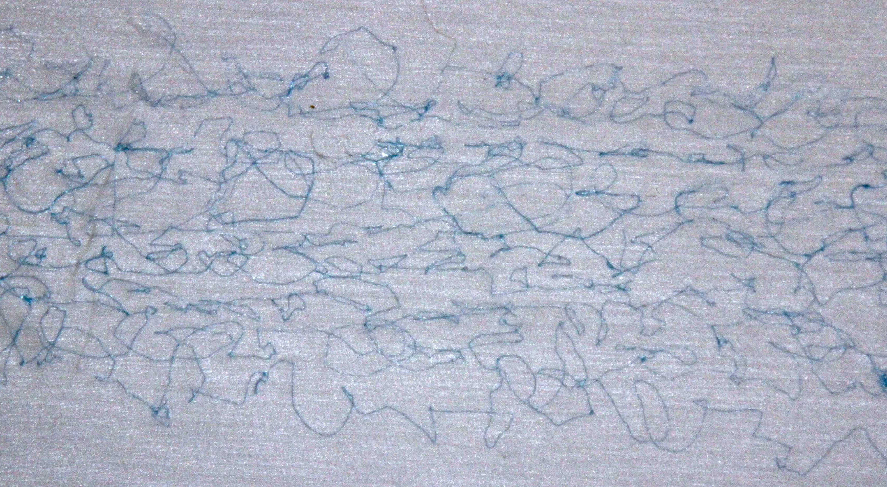
Spray pattern picture
>50% polymer/tackifier blend – no plasticizer – 2 gsm

Slide 15
Viscosity Stability
Stable viscosity over time → more consistent application
Allows for more flexibility in application

Slide 16
Production Considerations
Adhesive technology | High polymer content Olefins | SBC based products
Mixer technology | For low cost, high output can use extruder Upright batch mixer is sufficient but slower. | High shear needed – sigma blade or extruder
Handling of raw materials | Easily bulked | Must be bagged
Finishing form | Pellets with no coex coating | Coex pillows or other encapsulating method
Packaging form | Boxes, bulk bins, super sacks | Fiber drums
Handling of finished form | Could be air conveyed to application equipment | Drum unloader

Slide 17
Cost Considerations
Production costs – High polymer olefin adhesives will require less cost to produce vs. SBC products
  Made on more efficient equipment
  Made and finished at a faster rate
Packaging and Use cost
  High Olefin adhesives can be pelletized and boxed
  SBC are drummed
  Cost savings of $0.04/lb. using box or bag vs drum packaging

Slide 18
Cost considerations
Yield loss in use using SBC product
  Assume 0.75” of adhesive remains on bottom of drum after changing to new drum on drum unloader.
  This corresponds to about 9 lbs of adhesive left in bottom of drum. About 358 lbs are loaded into drum upon filling. This gives a 97% yield in use.
Pellets have a high potential of virtually 100% yield

Slide 19
Other Costs
Advantages in handling
Need to landfill waste drums
Use of pellets may minimize waste
  Recycle/reuse packaging

Slide 20
Cost Summation
 | High olefin adhesive | SBC
Manufacturing | lower | ---
Handling | easier | PSA, therefore may be problematic
Packaging | Savings of $0.04/lb | ---
Use efficiency | Close to 100% yield | About 97% yield
Disposal | Savings of $0.03/lb used | ---
For each 1MM lbs of adhesive, estimated cost savings are $70,000; NOT including the yield improvement or benefits achieved from the easier handling aspect.

Slide 21
Wrap Up
Trend in diaper construction adhesives is toward olefinic based adhesives
Advantages over SBC based products
Future potential - non-PSA type product
Advantages of non-PSA product
  Greater cost efficiency
  Cleaner running
  Handling

